Slide 1
Project
Movie data

Slide 2
Project Objective
The objective of the project is to use python programming to analyse a movie data to perform exploratory data analysis by answering the question in the upcoming slides.

Slide 3
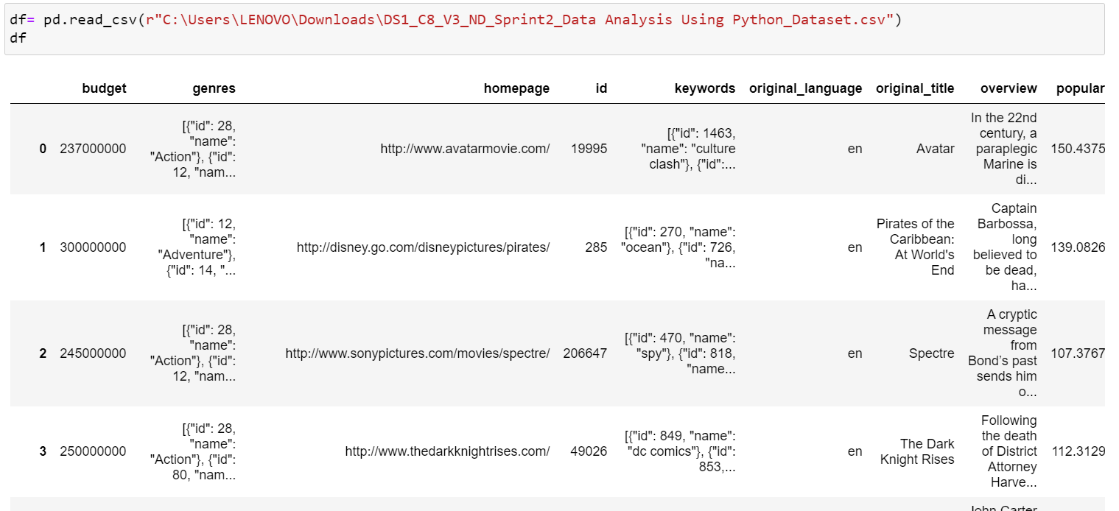
How to insult excel file or data into Jupyter notebook ?

Slide 4
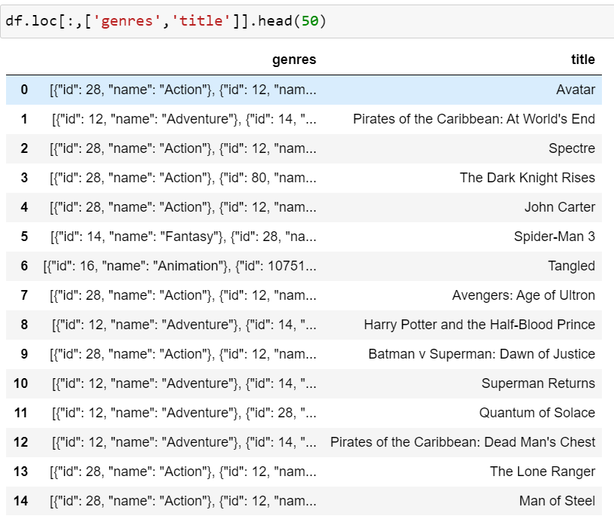
Task 1
Display the numbers of rows and columns in the dataset. Display the titles and genres of the first 50 movies from the dataset.

Slide 5
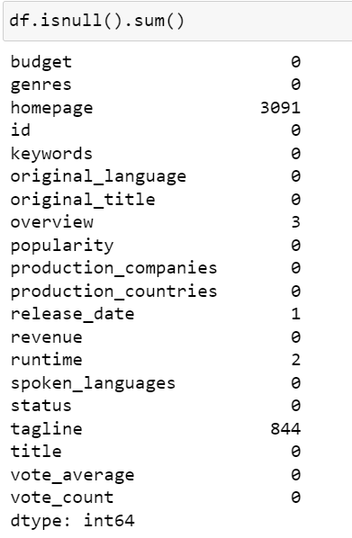
Task 2
Identify the columns that have null values and perform the null value treatment. (Choose the imputation method based on the type of data in the columns of interest)

Slide 6
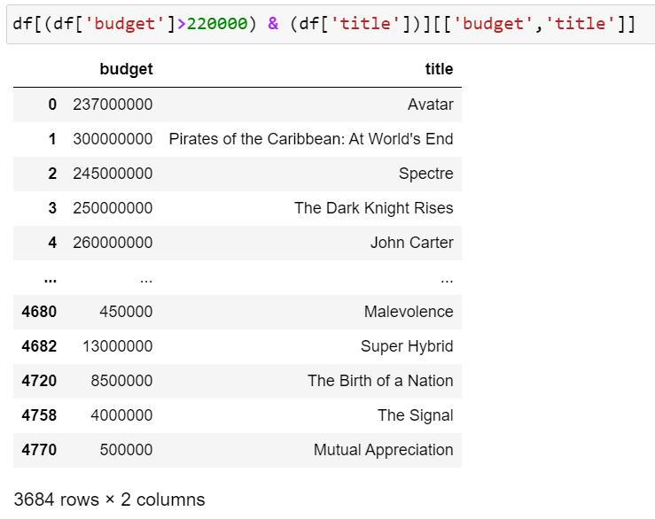
Task 3
Display the movie categories that have a budget greater than $220,000.

Slide 7
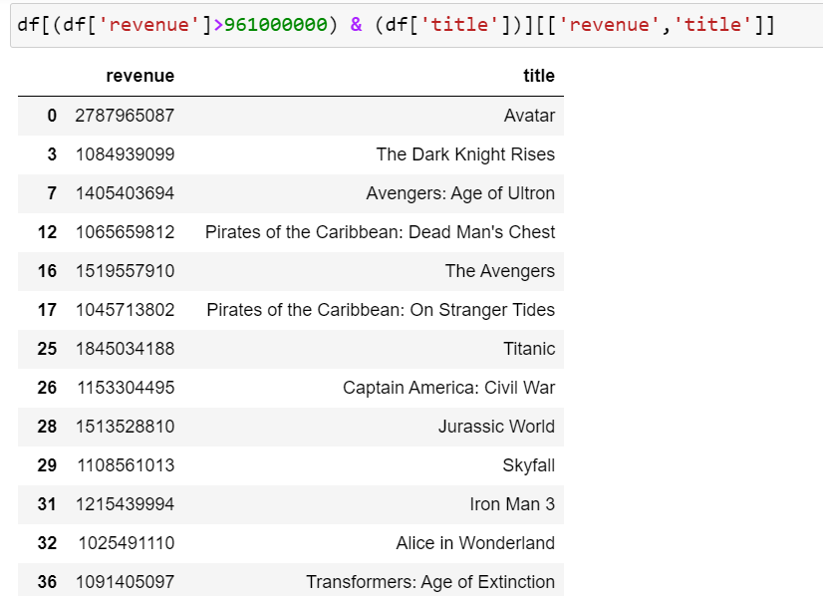
Task 4
Display the movie categories where the revenue is greater than 961,000,000.

Slide 8
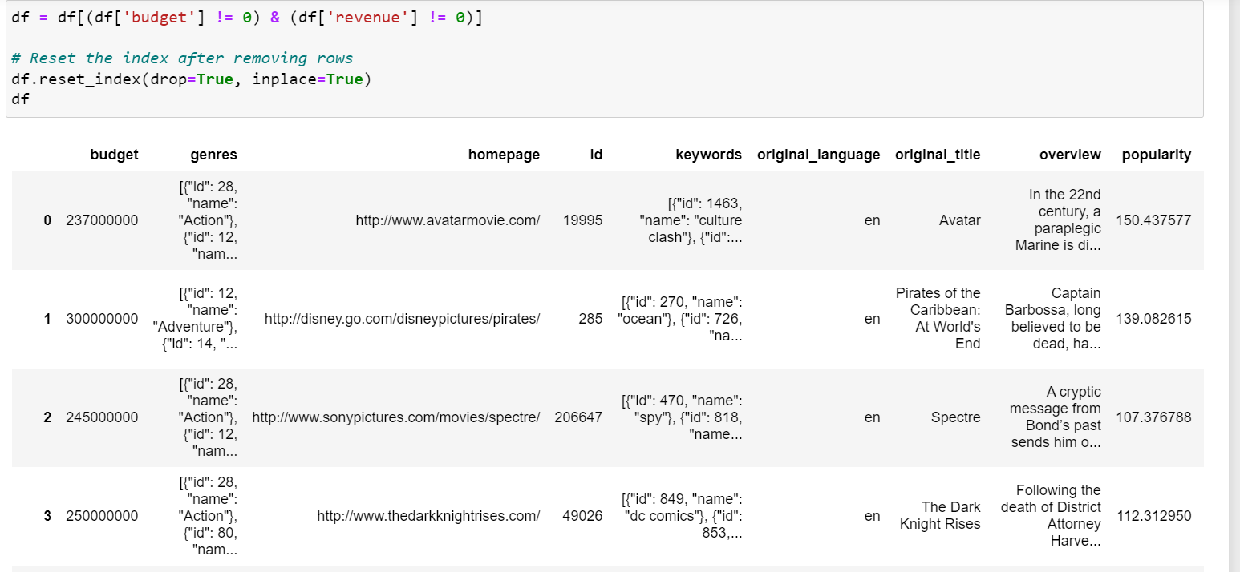
Task 5
In the dataset, there are some movies for which the budget and revenue columns have the value 0, which mean unknown values. Remove the rows with value 0 from both the budget and revenue columns.

Slide 9
Task 6
How are popularities of movies related with the movie budgets? Are they correlated or totally uncorrelated with each other? Write the interpretation of your analysis.

Slide 10
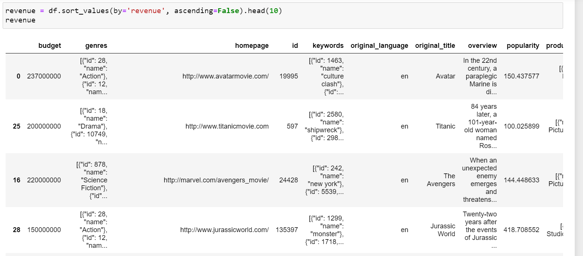
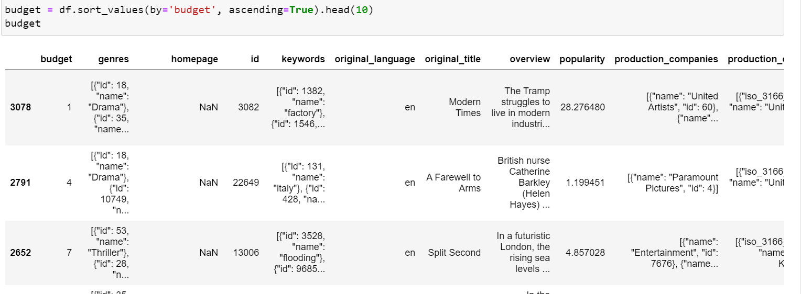

Slide 11

Task 7
Identify and display the names of all production companies along with the number of times they appear in the dataset.

Slide 12
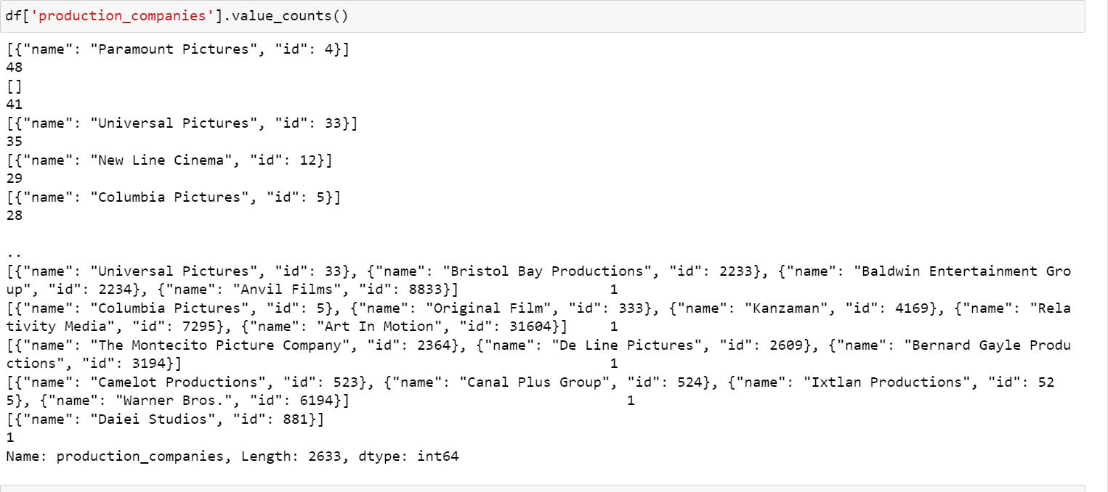
Task 8
Identify and display the names of all production companies along with the number of times they appear in the dataset.

Slide 13
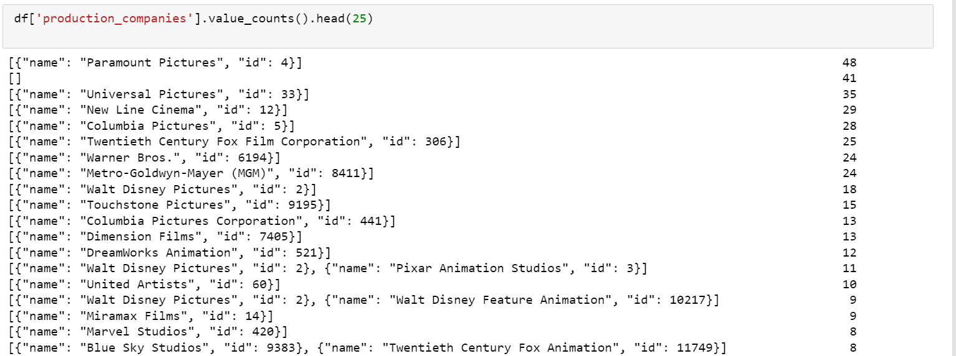
Task 9
Display the names of the top 25 production companies based on the number of movies they have produced in descending order of the number of movies produced.

Slide 14
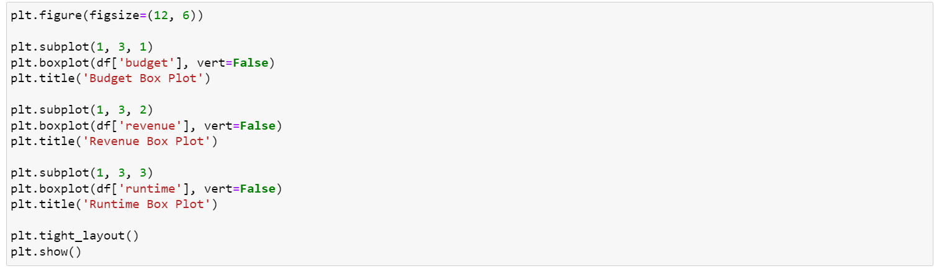
Task 10
Sort the data in descending order based on revenue and filter the top 500 movies. Find the measures of central tendency for the following columns using the filtered data:
1. budget
2. revenue
3. runtime
Perform outlier analysis for the above three columns using box plots.

Slide 15
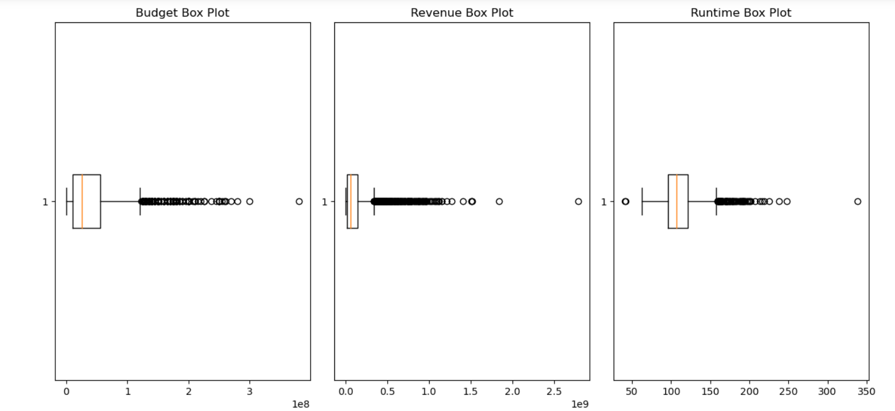

Slide 16
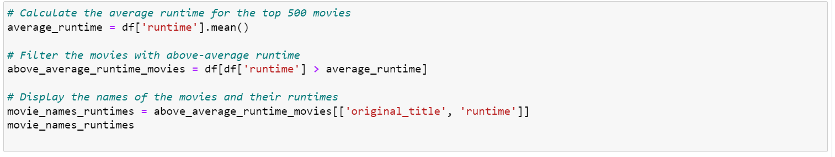
Task 11
Identify and display the names of the movies along with their run times for those movies that have above average runtime, using the data from the previous task.

Slide 17
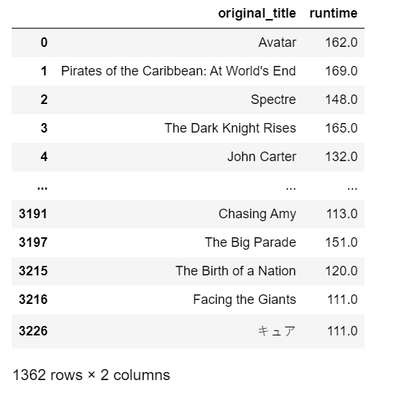

Slide 18


